Slide 1
S5™ System Operation Training Rob David Staff Field Applications Specialist (FAS)

Slide 2
Welcome – Ampliseq Transcriptome & S5TM System Operation Training
Trainer?
Rob David, Staff Field Applications Specialist (FAS) – Sequencing
Content:
Ion Torrent Basics & S5xL, OT2 & Chef System Operations
Discussion: Ion Libraries, Analysis workflow, Torrent Browser User Interface
Hands on OT2, Chef & S5xL
Table Set for Follow-up Training(s)
Applications Specific Hands-on Library
Bioinformatics Analysis
This is an open forum – please ask questions

Slide 3
Goals S5TM System Training
A strong working knowledge of the Ion S5™ System sequencing workflow including:
Library principals and QC validation
Ion Chef OT2 & S5™ system maintenance and sequencing workflow
Work with Torrent Browser for data monitoring and run report review/validation
Understand the basics of the data analysis process

Slide 4
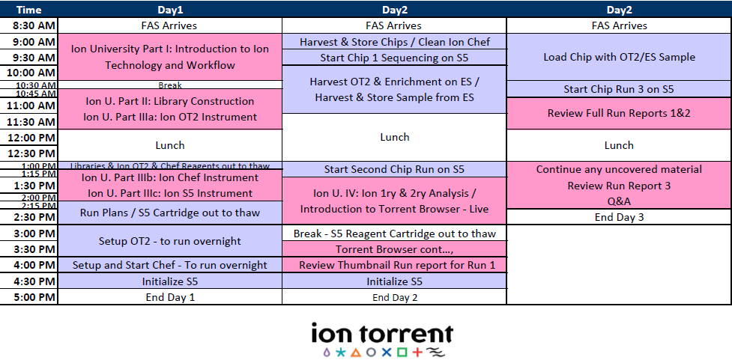
Agenda: Fragment & S5TM System Operational Training
Notes:
Note: Goal is to be compatible with existing libraries.

Slide 5
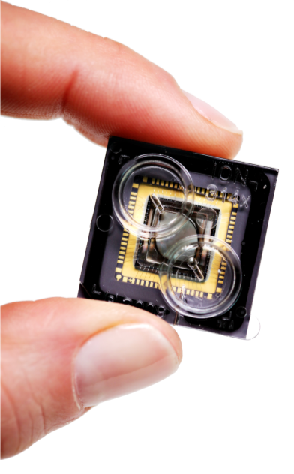

Ion Torrent™ : Semiconductor Sequencing for Life™
Support
Robert David
6178723352
Robert.David@thermofisher
ionsupport@lifetech.com
Call 800-955-6288 in USA
Bioinformatics support
ngs-amsupport@lifetech.com
Jingwei.Ni@thermofisher.com
Online info for Ion Torrent Systems Thermofisher Ion Community
The Chip is the Machine™
Notes:
PLEASE CHANGE TECH SUPPORT NUMBER TO MATCH YOUR REGION’S CONTACT INFORMATION – THIS IS US-ONLY

Slide 6

For Research Use Only. Not for use in diagnostic procedures.
Life Technologies is a Thermo Fisher Scientific brand. © 2014 Thermo Fisher Scientific Inc. All rights reserved. All trademarks are the property of Thermo Fisher Scientific and its subsidiaries.

